Slide 1
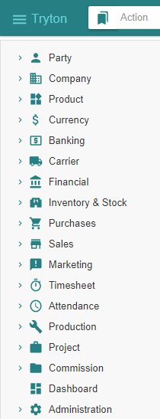
- Getting started - Sale
Tryton By Example
Github - https://github.com/clixwise/tryton-by-example Version of presentation : 6.0 Version of Tryton : 6.0 Verified for execution on : Windows 10 & Powershell 7 Licence : CC BY 4.0 Author : Marc Rottiers

Slide 2
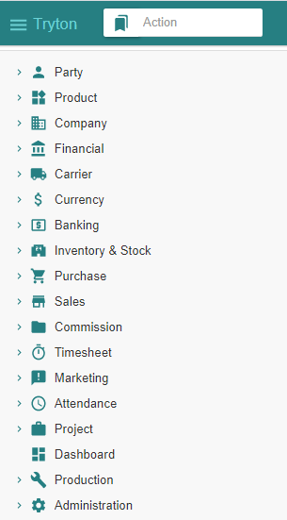
Table of Contents

Slide 3
TOC
MODULE ACTIVATION
Customer
Product
Inventory & Stock
Sale
STATE CHANGES
State Change - Impact Analysis Model
SALE PROCESS
Customer Sale
Customer Shipment
Customer Invoice
Customer Payment
Customer-related modules have been activated
Product-related modules have been activated
Stock-related modules have been activated
Activating Sale-related modules
The state diagram for “Sale” related operations
Recording a Sale
Recording a Shipment
Emitting an Invoice
Paying an Invoice

Slide 4
Chart of Accounts (Recap)

Slide 5
Chart of Account
We have installed the « French » chart of accounts : refer to « Basic Functionality » document.
We use the following accounts for the sale process
Balance Sheet Accounts
Income Statement Accounts
# | French | English
40 | Client | Customer
53 | Caisse | Cash
# | French | English
7x | Revenus | Revenue

Slide 6
Customer

Slide 7
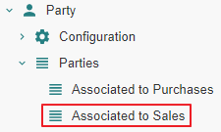
Motivation
Customers are named « Parties associated to Sales ». We name them hereafter « Customer » for commodity.
Customers are in fact party entity roles : any party promotes to a customer as soon as one or more sales are linked to it. Same for purchases.
Creation : a customer can be defined by creating an instance with the Menu Tree Item
« Parties » or
« Parties associated to Sales » if it exists (see Access hereafter).
Access : as long as no sale is linked to a party, it is not recognized as a customer and will only be accessible using the Menu Tree Item « Parties ».
Note finally that « Party » modules have been activated as explained in the previous document « Basic Functionality ».

Slide 8
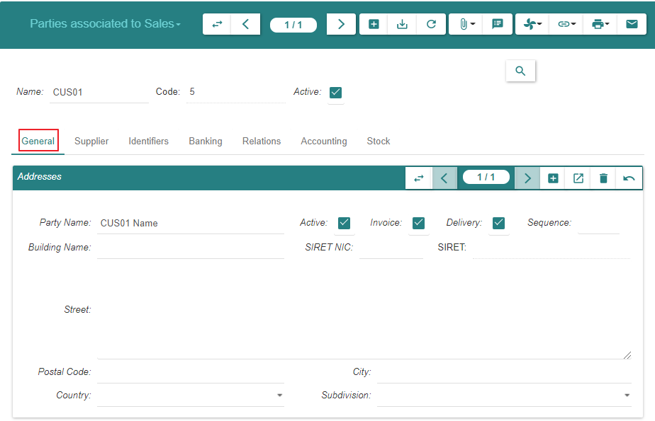
Create

Slide 9
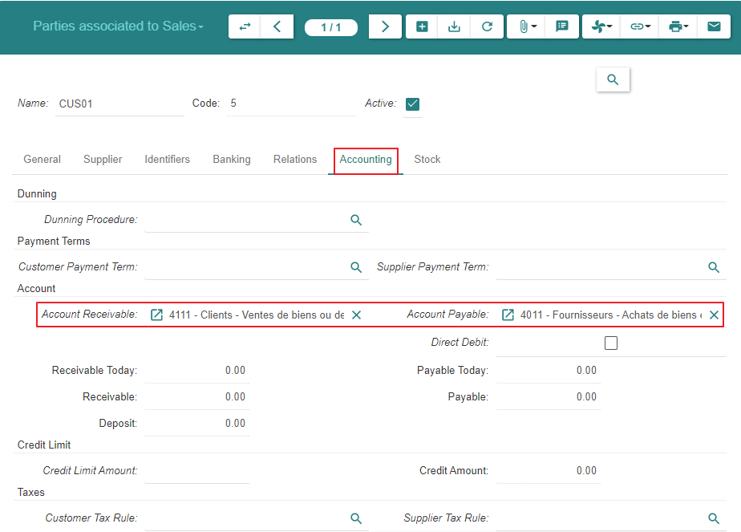
Create

Slide 10
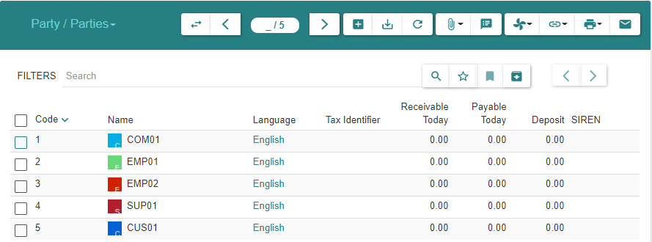
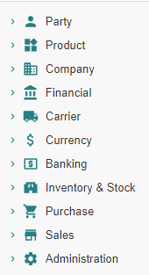
Summary
As explained under « Motivation », the customer always appears in the list « Parties » above
As long as there are no sales linked to the customer, it is absent from « Parties associated to Sales »
When at least one sale exists, the customer will appear in both lists : « Parties » and « Parties associated to Sales »

Slide 11
Product

Slide 12
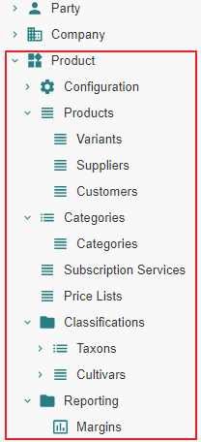
Motivation
Subject Area « Purchase » : « Product » related modules have been activated
Subject Area « Purchase » : a « Product » and its « Variant » have been defined

Slide 13
Inventory & Stock

Slide 14
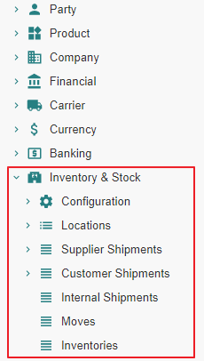
Motivation
Subject Area « Purchase » : « Inventory & Stock » related modules have been activated

Slide 15
Sale

Slide 16
Module Activation

Slide 17
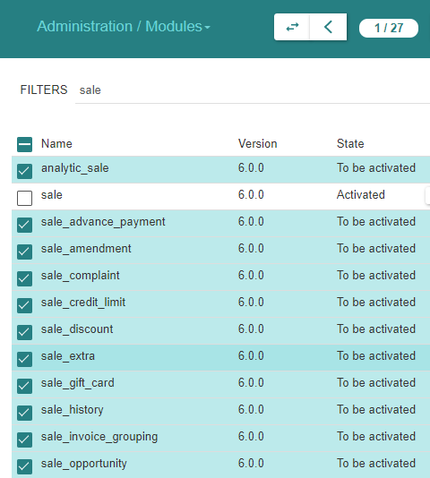
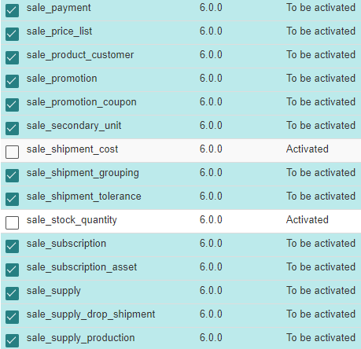
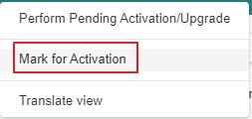
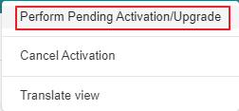
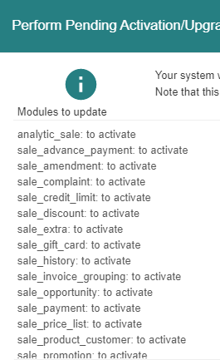
Module Activation

Slide 18
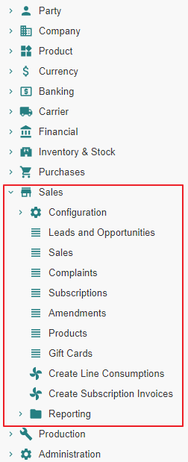
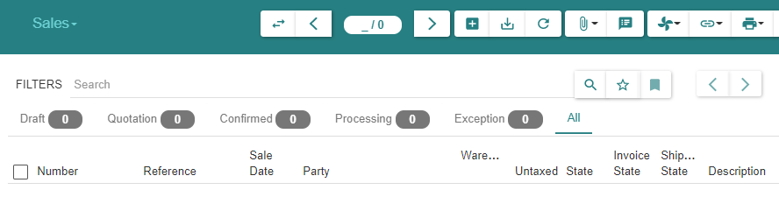
State « Post »

Slide 19
Sale Configuration

Slide 20
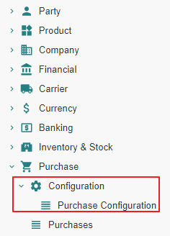
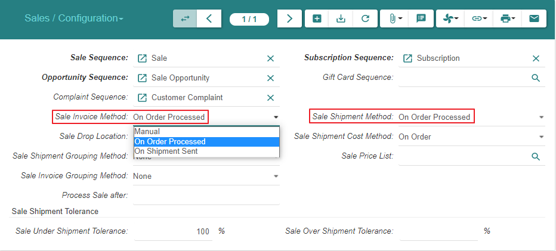
Sale Configuration (1/2)

Slide 21
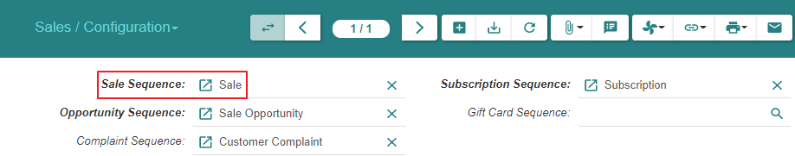
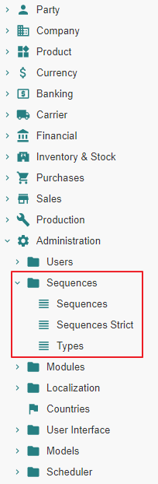
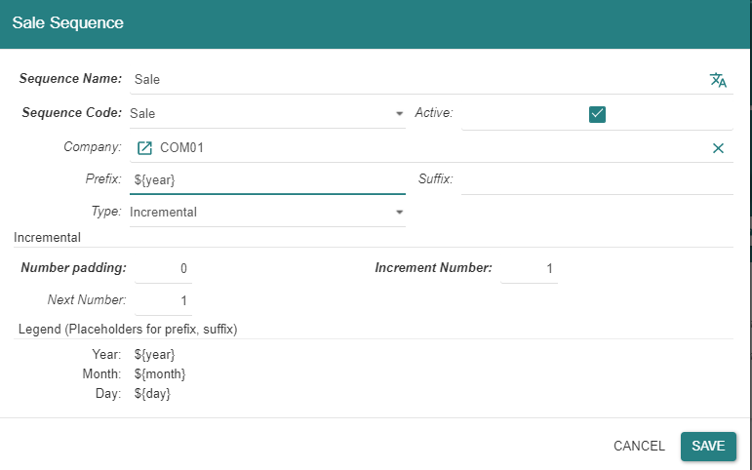
Sale Configuration (2/2)
Note : all sequences are also accessible thru Menu Tree Item « Administration / Sequences »

Slide 22
Sale - State Changes - Impact Analysis Model

Slide 23
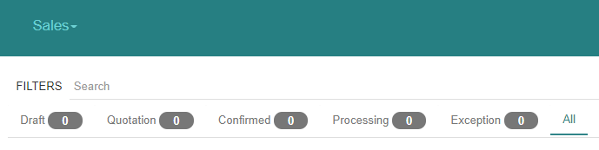
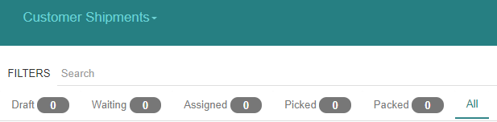
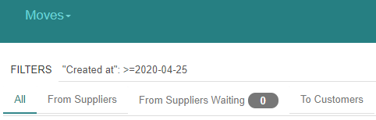
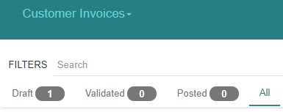
« Sales » related states

Slide 24
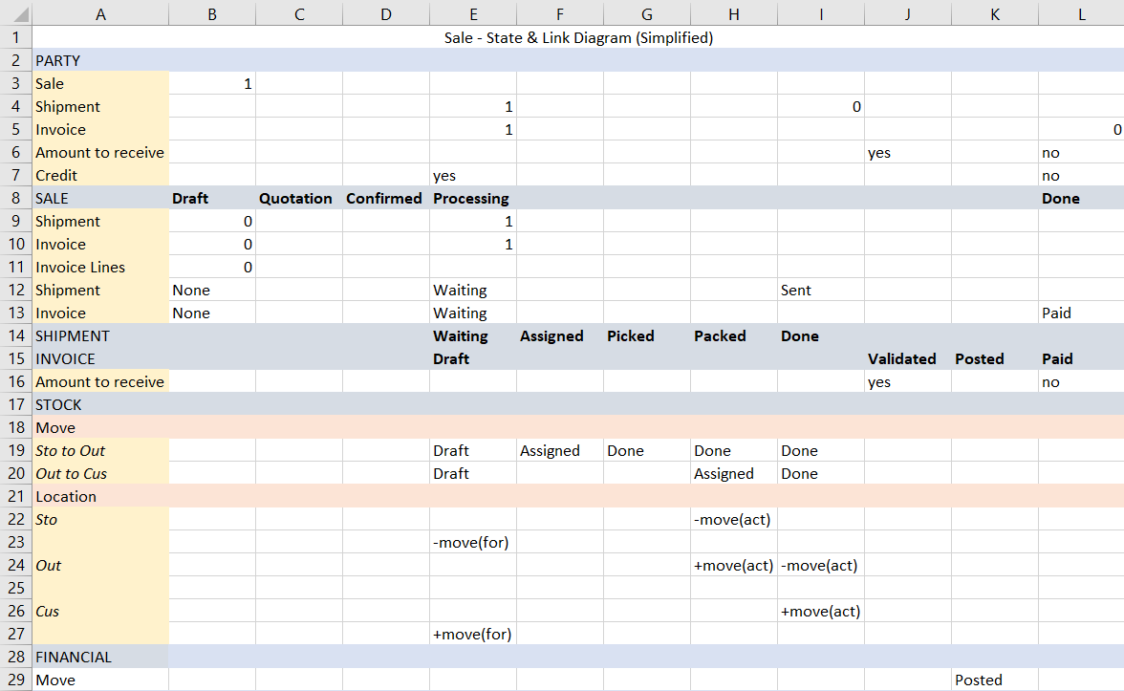

Slide 25
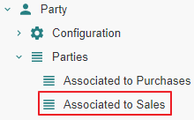
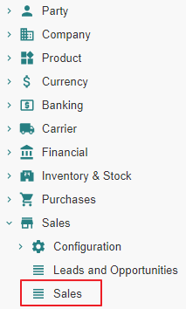
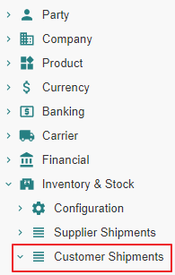
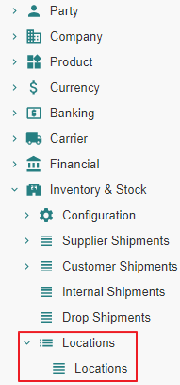
Impact analysis - list of functions

Slide 26
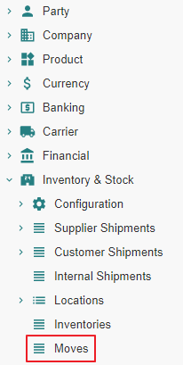
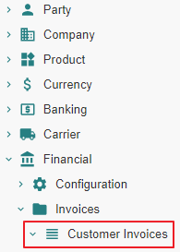
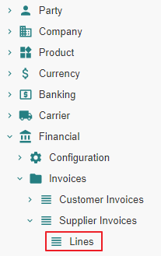
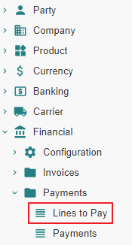
Impact analysis - list of functions

Slide 27
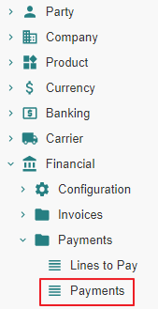
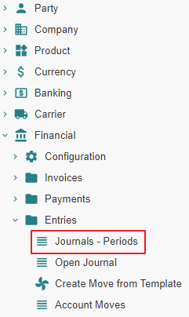
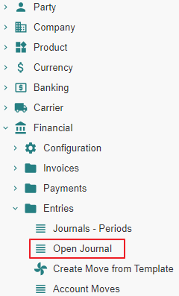
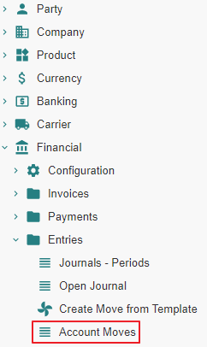
Impact analysis - list of functions

Slide 28
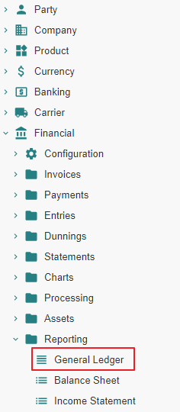
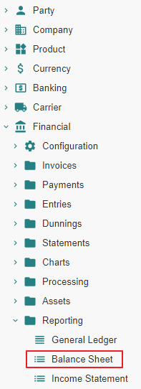
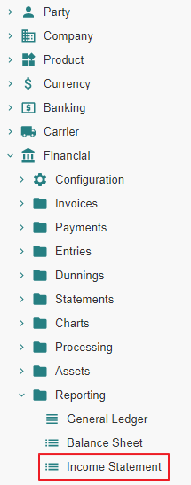
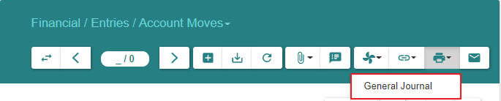
Impact analysis - list of functions

Slide 29
Customer Sale - State Changes - Impact Analysis

Slide 30
Sale From State « Nill » to State « Draft »

Slide 31
Sale From State « Nill » to State « Draft » Action

Slide 32
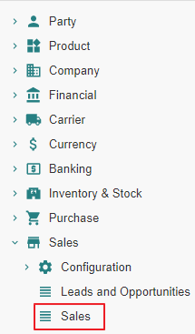
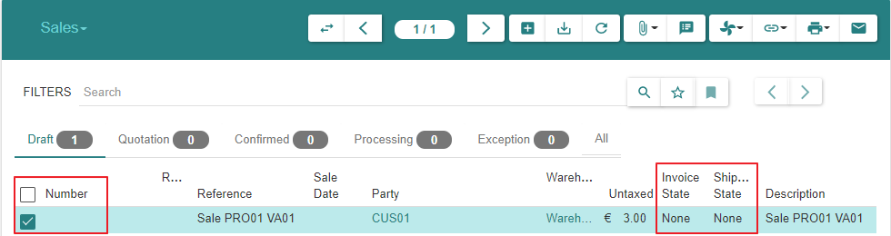
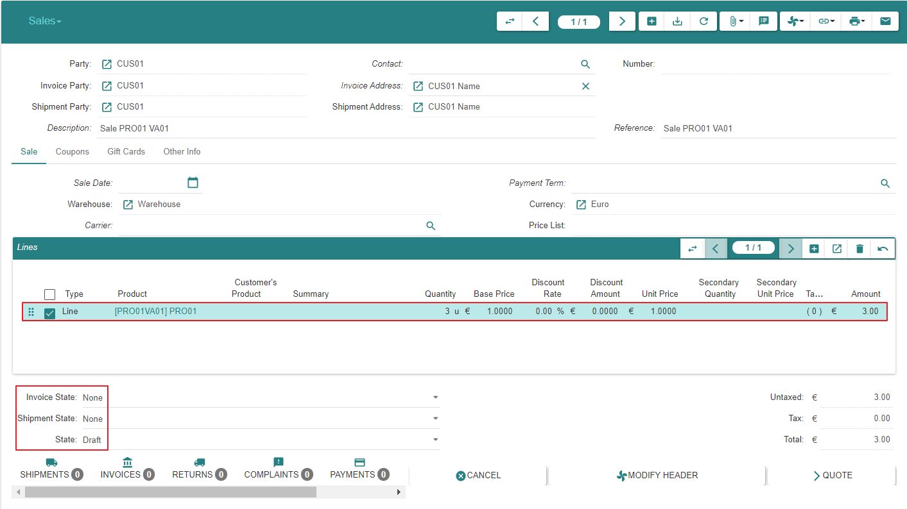
Sale
Sales are not numbered whilst they are in state « Draft »

Slide 33
Sale From State « Nill » to State « Draft » Impact

Slide 34
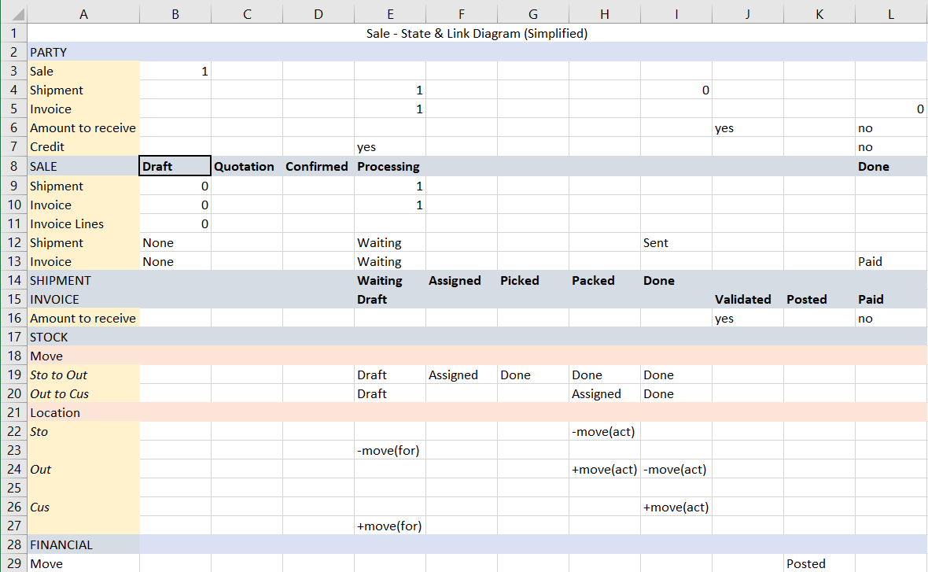

Slide 35
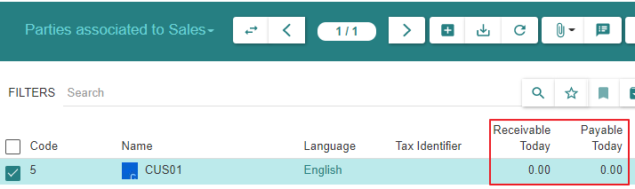
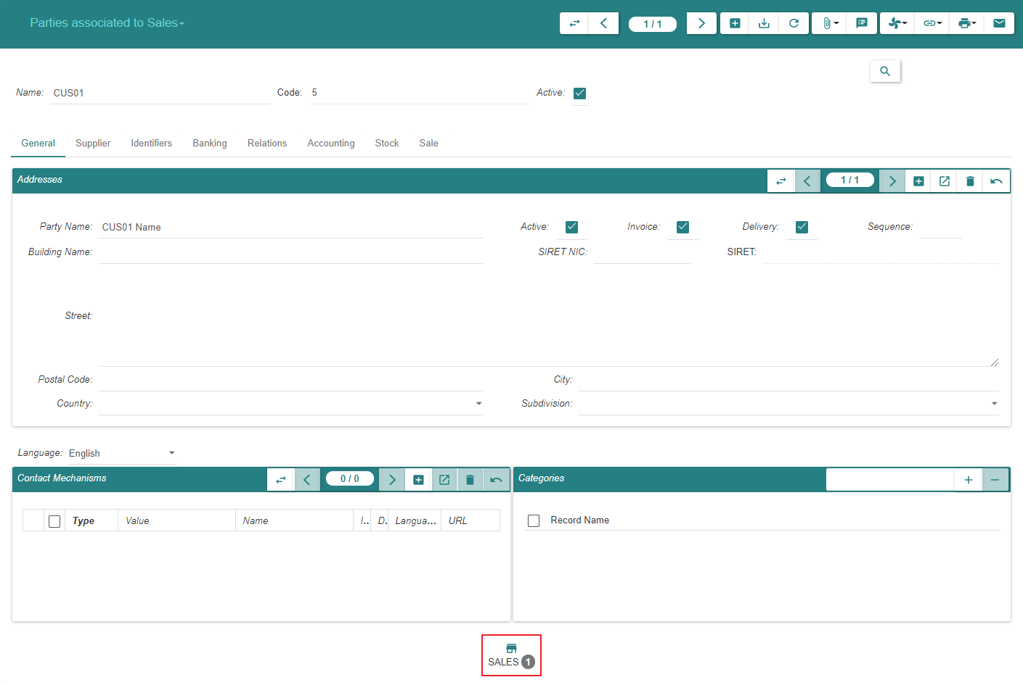
1 - Parties associated to Sales
We can navigate to « Sales », « Shipments » or « Invoices » from here on or from Menu Items

Slide 36
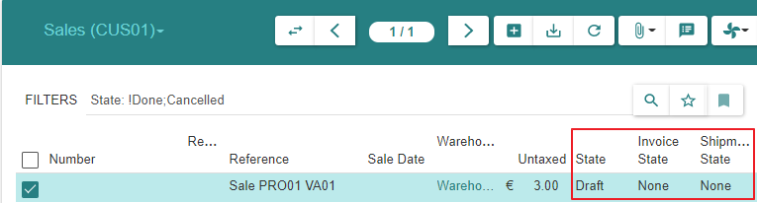
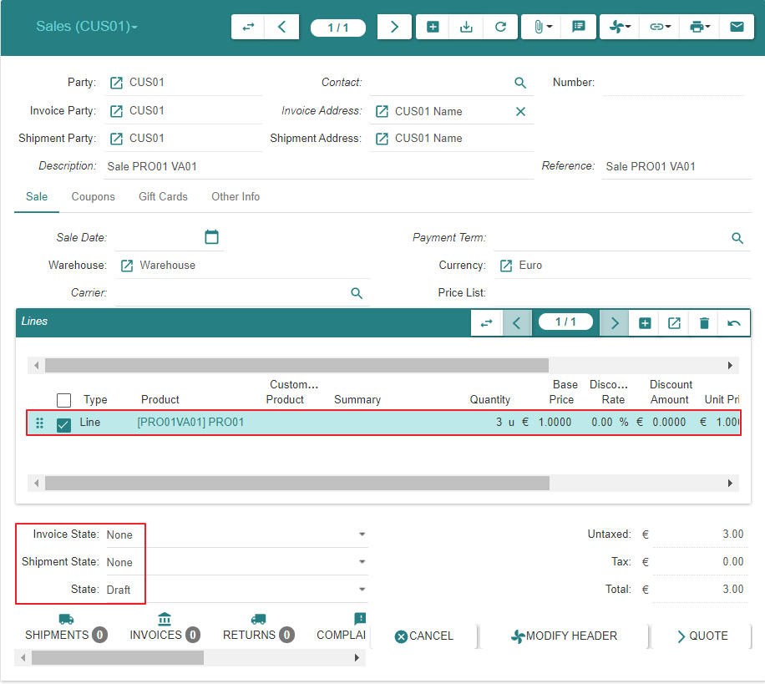
2 - Sales | Sales (SUP01)

Slide 37


8 - Lines to Pay

Slide 38

9 - Payments

Slide 39




10 - Journals - Periods

Slide 40


11 - Account Moves

Slide 41

11 - Account Moves

Slide 42


12 - Open Journal

Slide 43


12 - Open Journal

Slide 44


13 - General Ledger

Slide 45

14 - Balance Sheet

Slide 46

14 - Balance Sheet

Slide 47

16 - General Journal

Slide 48
Sale From State « Draft » to State « Quotation »

Slide 49
Sale From State « Draft » to State « Quotation » Action

Slide 50


Sale
Sales are numbered when they reach state « Quotation »
Sales can be returned to state « Draft », e.g. when the price has been renegociated with the « Customer »

Slide 51
Sale From State « Draft » to State « Quotation » Impact

Slide 52


Slide 53


1 - Parties associated to Sales
We can navigate to « Sales », « Shipments » or « Invoices » from here on or from Menu Items

Slide 54


2 - Sales | Sales (CUS01)

Slide 55
Sale From State « Quotation » to State « Confirmed » or From State « Quotation » to State « Processing »

Slide 56
Sale From State « Quotation » to State «Processing »

Slide 57
Sale From State « Quotation » to State «Processing » Action

Slide 58
State transitions
Upon « Confirm » action by the user, a « Sale » or « Purchase » evolves from state « Quotation » to :
State « Confirmed » when a latent sale processing error condition exists
State « Processing » when such error does not exist.
- In the present scenario, there is no error condition and the state transition is from « Quotation » to « Processing »
Confirmed
Confirm
-
Sale Processing related Error Condition Exists
Confirm
-
Sale Processing related Error Condition Resolved
Confirm
-
Sale Processing possible
Confirm
Quotation
Processing

Slide 59


Sale

Slide 60

Sale

Slide 61
Sale From State « Quotation » to State «Processing » Impact

Slide 62


Slide 63

1 - Parties associated to Sales

Slide 64


2 - Sales | Sales (CUS01)

Slide 65


3 - Customer Shipments | Customer Shipments (CUS01)
The « Customer Shipment » is created in state « Waiting », not « Draft »
Althoug the « Customer Shipment » can be reverted subsequently to state « Draft », it should be noted that its property « Reference » cannot be edited anymore

Slide 66


3 - Customer Shipments | Customer Shipments (CUS01)

Slide 67


4 - Stock Locations

Slide 68



4 - Stock Locations : Storage Zone - Output Zone - Customer

Slide 69

5 - Stock Moves

Slide 70

5 - Stock Moves

Slide 71

5 - Stock Moves

Slide 72



6 - Invoices | Invoices (CUS01)

Slide 73

6 - Invoices | Invoices (CUS01)

Slide 74

7 - Invoice Lines

Slide 75
Customer Shipment - State Changes - Actual States

Slide 76
Motivation
It is certainly possible to process the shipment(s) pertaining to a « Sale » using the « Move » menu item.
However, it is recommended to proceed using the « Customer Shipment » functionality which will manage the following stock moves in a coherent fashion :
« Storage Moves » between the warehouse storage location and the warehouse output location
« Outgoing Moves » between the warehouse output location and the customer location

Slide 77
Customer Shipment « Nill » To « Draft »

Slide 78
Creation
The « Customer Shipment » is initially created in state « Waiting », not « Draft »
This occurs when the « Sale » evolves into state « Processing »
Hence, we do not document the inexisting state « Draft »

Slide 79
Customer Shipment « Nill » To « Waiting »

Slide 80
Creation
The « Customer Shipment » is created in state « Waiting »
This occurs when « Sale » evolves into state « Processing »

Slide 81
Customer Shipment « Waiting » To « Assigned »

Slide 82
Customer Shipment From « Waiting » To « Assigned » Action

Slide 83

Customer Shipments - Inventory Moves

Slide 84

Customer Shipments - Outgoing Moves

Slide 85
Customer Shipment From « Waiting » To « Assigned » Impact

Slide 86


Slide 87


2 - Sales | Sales (CUS01)

Slide 88



3 - Customer Shipments | Customer Shipments (CUS01)

Slide 89


5 - Stock Moves

Slide 90
Customer Shipment From « Assigned » to « Picked »

Slide 91
Customer Shipment From « Assigned » to « Picked » Action

Slide 92

Customer Shipments - Inventory Moves

Slide 93

Customer Shipments - Outgoing Moves

Slide 94
Customer Shipment From « Assigned » to « Picked » Impact

Slide 95


Slide 96



3 - Customer Shipments | Customer Shipments (CUS01)

Slide 97

5 - Stock Moves

Slide 98
Customer Shipment From « Picked » to « Packed »

Slide 99
Customer Shipment From « Picked » to « Packed » Action

Slide 100


Customer Shipments - Inventory Moves

Slide 101

Customer Shipments - Outgoing Moves

Slide 102
Customer Shipment From « Picked » to « Packed » Impact

Slide 103


Slide 104



3 - Customer Shipments | Customer Shipments (CUS01)

Slide 105

3 - Customer Shipments | Customer Shipments (CUS01)

Slide 106
4 - Stock Locations : Storage Zone - Output Zone - Customer

Slide 107



4 - Stock Locations : Storage Zone - Output Zone - Customer

Slide 108

5 - Stock Moves

Slide 109
Customer Shipment From « Packed » to « Done »

Slide 110
Customer Shipment From « Packed » to « Done » Action

Slide 111

Customer Shipments - Inventory Moves

Slide 112

Customer Shipments - Outgoing Moves

Slide 113
Customer Shipment From « Packed » to « Done » Impact

Slide 114


Slide 115

1 - Parties associated to Sales

Slide 116


2 - Sales | Sales (CUS01)

Slide 117



3 - Customer Shipments | Customer Shipments (CUS01)

Slide 118
4 - Stock Locations

Slide 119



4 - Stock Locations : Storage Zone - Output Zone - Customer

Slide 120

5 - Stock Moves

Slide 121
Customer Invoice - State Changes - Actual States

Slide 122
Customer Invoice « Nill » To « Draft »

Slide 123
Creation
The « Customer Invoice » is initially created in state « Draft »
The system creates such invoice when the « Sale » evolves into state « Processing »

Slide 124


Invoice

Slide 125
Customer Invoice « Draft » To « Validated »

Slide 126
Customer Invoice From « Draft » To « Validated » Action

Slide 127

Customer Invoices (1/2)

Slide 128

Customer Invoices (2/2)

Slide 129
Customer Invoice From « Draft » To « Validated » Impact

Slide 130


Slide 131

1 - Parties associated to Sales

Slide 132


2 - Sales | Sales (CUS01)

Slide 133
6 - Invoices | Invoices (CUS01) (1/2)

Slide 134
6 - Invoices | Invoices (CUS01) (2/2)

Slide 135



10 - Journals - Periods

Slide 136

11 - Account Moves

Slide 137

12 - Open Journal

Slide 138
13 - General Ledger

Slide 139
14 - Balance Sheet

Slide 140
14 - Balance Sheet

Slide 141
16 - General Journal

Slide 142
Customer Invoices From State « Validated » to State « Posted »

Slide 143

Motivation
https://www.accountingtools.com/articles/what-is-posting-in-accounting.html

Slide 144
Customer Invoices From State « Validated » to State « Posted » Action

Slide 145


Customer Invoices (1/2)

Slide 146

Customer Invoices (2/2)

Slide 147
Customer Invoices From State « Validated » to State « Posted » Impact

Slide 148


Slide 149


1 - Parties associated to Sales

Slide 150


2 - Sales | Sales (CUS01)

Slide 151
6 - Customer Invoices (1/2)

Slide 152
6 - Customer Invoices (2/2)

Slide 153

8 - Lines to Pay

Slide 154
9 - Payments

Slide 155



10 - Journals - Periods

Slide 156

11 - Account Moves

Slide 157

11 - Account Moves

Slide 158

11 - Account Moves

Slide 159




12 - Open Journal

Slide 160

13 - General Ledger

Slide 161

14 - Balance Sheet

Slide 162

14 - Balance Sheet

Slide 163

15 - Income Statement

Slide 164

16 - General Journal

Slide 165
Customer Payment - State Changes - Actual States

Slide 166
Payment

Slide 167
Payment Precondition

Slide 168




Invoice Payment Method

Slide 169
Payment Action

Slide 170



Customer Invoices (1/2)

Slide 171

Customer Invoices (2/2)

Slide 172
Payment Impact

Slide 173


Slide 174


1 - Parties associated to Sales

Slide 175

1 - Parties associated to Sales

Slide 176


2 - Sales | Sales (CUS01)

Slide 177
6 - Customer Invoices (1/2)

Slide 178
6 - Customer Invoices (2/2)

Slide 179

10 - Journals - Periods

Slide 180

11 - Account Moves

Slide 181
11 - Account Moves

Slide 182

11 - Account Moves

Slide 183

12 - Open Journal

Slide 184
13 - General Ledger

Slide 185

14 - Balance Sheet

Slide 186

14 - Balance Sheet

Slide 187

16 - General Journal

